Slide 1
DEMOWEBSHOP
Team-3

Slide 2
RLL_TEAM-3
NAME | EMPLOYEE-ID
Shaik Sameena | 2580069
Sabbani Saikiran | 2580331
Akkala Adi Sankar Reddy | 2580146
Kripa Murugan | 2579892
Utkarsh Sharma | 2579974
Danush Rasu | 2580378
Manish D R | 2580322
Gaurav Mall | 2580194

Slide 3


Agenda
A
Introduction
Objectives
Modules
Test Scenario
Technologies Used
Screenshots
Conclusion

Slide 4
INTRODUCTION

Slide 5
In this project we are testing the functionalities of the website: https://demowebshop.tricentis.com/
Here we have given the importance about automation in testing scenarios with the help of Excel to read data.
The tools and Framework which we have worked here are: Java, Selenium WebDriver, TestNG, Jenkins (optional), Cucumber-Java.
Project Objectives are to Create a test script for automation and generate reports for the e-Commerce website on efficiency and reliability in testing.
For the failed test cases we have used IRetry Analyser and screenshots for capturing the failed test cases.

Slide 6
OBJECTIVES

Slide 7
Automation is a key focus of the project for testing scenarios on the DemoWebShop website.
The project emphasizes the use of Excel for data-driven testing. Test scripts are designed to read data from Excel files, allowing for flexible and extensive testing scenarios.
The primary objective is to create effective and efficient test scripts using the specified tools and frameworks.
The project aims to generate comprehensive reports to evaluate the efficiency and reliability of testing on the DemoWebShop website.
Cucumber-Java is used, indicating a focus on Behavior-Driven Development (BDD) principles. This involves creating readable and understandable test scenarios in natural language.
The primary goal is to assess the efficiency and reliability of the testing process, ensuring that the automated scripts effectively verify the functionality of the DemoWebShop website.

Slide 8
Modules
M
Register
Login
Add/Remove product to Cart
Add/Remove product to Wishlist
Checkout
Search
Community Poll
Newsletter Subscription

Slide 9
TEST SCENARIO

Slide 10
Register
To test new registration with valid credentials
To test new registration with already exist credentials
To test new registration with empty Email-id
To test new registration with empty confirm Password
To test new registration with invalid Password
Login
To verify the user can enter and submit valid login credentials
To verify the user can enter and submit invalid Email and valid Password
To verify the user can enter and submit valid Email and invalid Password
To verify the user can enter and submit invalid login credentials
To verify the user can enter and submit blank credentials
Add/Remove product to Cart
Confirm AddToCart button is clickable or not
Confirm whether all books having AddToCart button or not
Add the third book from book menu into the cart
Add any three products into card, deleting any two products from cart
Check the checkbox is enabled for removing the product from cart

Slide 11
Add/Remove product to Wishlist
Verify user navigates to Digital Downloads
User adds the products to wishlist
User navigates to the wishlist
User removes the product from wishlist
User validates the wishlist after deletion
Checkout
Confirm billing address and click continue
Confirm shipping address
Adding shipping method
Add payment methods
Payment information
Check the order confirmation
Search
Click search without entering text
Verify the behavior when specific categories are entered in the search tab

Slide 12
Verify the behavior when valid names are entered in search placeholder
Validate the system’s ability to handle synonyms and correct common typos in search queries
Community Poll
To verify that the user can perform Community Poll by login
To verify that existing user can perform Community Poll by login
To verify that the user can perform Community Poll without login
To verify that the user can perform Community Poll by directly clicking on vote
Newsletter Subscription
Verify that user can subscribe to newsletter with valid Email id
Verify that user can subscribe to newsletter with invalid Email id format
Verify that user can subscribe to newsletter with invalid Email id format with numbers
Verify that user can subscribe to newsletter with blank Email id
Verify that user can subscribe to newsletter with valid Email id
Verify that user can subscribe to newsletter with different types of Email id

Slide 13
TECHNOLOGIES USED

Slide 14

TestNG
TestNG is a testing framework for the Java programming language created by Cédric Beust and inspired by JUnit and NUnit.
It is designed to cover all categories of tests: unit, functional, end-to-end, integration, and more.
TestNG is widely used in the software development industry for its ease of use, flexibility, and robust features

Slide 15
Implementing TestNG
Annotations
TestNG provides powerful annotations such as @BeforeSuite, @AfterSuite, @BeforeTest, @AfterTest, @BeforeClass, @AfterClass, @BeforeMethod, and @AfterMethod. These annotations allow structured control over test cases and suites.
Data Providers
TestNG supports the use of Data Providers, enabling the execution of the same test with different sets of data. This is particularly useful for data-driven testing scenarios.
Parallel Execution
TestNG is capable of running tests in parallel, which significantly reduces the time required for test execution, making the testing process faster and more efficient.

Slide 16
Advantages of TestNG
Flexible Configuration
TestNG allows for flexible configuration of test suites, test cases, and test methods through XML files or annotations. This makes it easy to configure and manage test environments.
Report Generation
TestNG generates comprehensive HTML reports, providing detailed test results and statistics. These reports are easy to understand and help in identifying test failures quickly.
Data Parameterization
TestNG supports parameterization of test methods, allowing multiple sets of data to be passed to the same test, enhancing the reusability of test cases.
TestNG in Automation Testing
Test Suites
TestNG enables the creation of test suites, where multiple test classes can be grouped together. This helps in executing a set of related test cases as a single unit.

Slide 17
Assertions
TestNG provides a wide range of assertion methods, making it easy to perform validation checks and verify expected outcomes in test cases.
Listeners
TestNG listeners allow customizing the test execution flow and performing certain actions based on test events, providing greater control and flexibility in automation testing.
Best Practices for TestNG
Modular Test Design
It is recommended to design modular test cases that are independent, reusable, and maintainable, promoting efficient and effective test automation.
Effective Reporting
Utilize TestNG's reporting capabilities to generate detailed and insightful reports, facilitating better analysis and decision-making based on test results.

Slide 18
Parameterization Strategy
Develop a robust parameterization strategy to enhance the versatility and coverage of test scenarios, improving overall test effectiveness.
Integration of TestNG with Selenium
Test Scripts
Integrate TestNG with Selenium WebDriver to create robust and maintainable test scripts for web application testing.
Synchronization
Use TestNG annotations to manage synchronization and ensure proper sequencing of test actions in Selenium test cases.

Slide 19

Cucumber
Cucumber is a high-level testing framework that supports behavior driven development.
It runs automated acceptance tests on web applications.
Cucumber is a tool that executes plain-text functional descriptions as automated tests.
The language that Cucumber understands is called Gherkin.

Slide 20
What is Gherkins ?
Gherkins is the language that cucumber understands, it is a bussiness Readable, domain specific language that lets you describe software behavior with out detailing its implementation.
Single Gherkin source file contains a description of a single feature.
Source files have feature extension
Feature
Every feature file conventionally consists of a single feature. A line starting with the keyword Feature followed by free indented text starts a feature. A feature usually contains a list of scenarios. scenarios together independent of your file and directory structure
Feature: Single file, ideally describing a single feature
Scenario: A test case
Given-When-Then: Test Preconditions, Execution and Postconditions
And: Additional test constructs

Slide 21
What are the benefits?
It is helpful to involve business stakeholders who can't easily read code
Cucumber focuses on end-user experience
Style of writing tests allow for easier reuse of code in the tests
Quick and easy setup and execution
Efficient tool for testing
Instead of writing your tests purely in code, with Cucumber you start by writing a human-readable user story. Then, you write code to run the story and perform test(s) based on it.

Slide 22

JUnit
JUnit is a widely used testing framework for Java that facilitates unit testing. It focuses on ensuring the individual units of code function correctly.
JUnit executes automated tests on Java applications, primarily focusing on unit tests.
JUnit allows developers to write test cases and ensure that individual units of code produce expected results.

Slide 23
What is JUnit?
JUnit uses Java as its primary language and follows a syntax that helps developers structure and execute tests efficiently.
Test methods are annotated with @Test to indicate they are test cases.
Test Structure
In JUnit, a test class typically contains multiple test methods, each annotated with @Test. Developers can use various annotations for setup (@Before), teardown (@After), and other configurations.
Benefits of JUnit:
JUnit enables developers to create and run tests easily, ensuring code reliability.
It allows for the systematic organization of tests, helping developers maintain a structured testing suite.
Integration with build tools and continuous integration systems simplifies the testing process.
Provides annotations for setup, teardown, and other lifecycle methods, enhancing test control.
Developers can perform parameterized testing using annotations like @Parameterized.
Facilitates test-driven development (TDD) by encouraging writing tests before code implementation.
JUnit contributes to the robustness of Java applications by supporting developers in writing and executing effective unit tests.

Slide 24
Data Driven Testing
Data-driven testing with a scenario-outline is a simple task using Cucumber.
Data Driven Testing, which allows to automatically run a test case multiple times with different input and validation values.
Test parameters, such as input values, expected results, and configuration settings, are externalized from the test scripts. This allows the same test logic to be executed with different datasets.
And the good part is that the Cucumber inherently supports Data Driven Testing using Scenario Outline.

Slide 25
Cucumber Scenario Outline Data-Driven Testing
Examples of Parameterization with a Suggested Keyword
Table-Based Parameterization
Cucumber with External Files Data-Driven Testing
XML-based parameterization
Json-based parameterization
The Use of Excel Files for Parameterization
Why We Need Data-Driven Testing?
Data-driven testing reduces the time spent on test upkeep because instead of maintaining multiple test cases, you just need to maintain a single test case that checks all possible combinations of data values.
Reusability is improved, and it's also simple to keep up with.
Only one test case is necessary to cover all possible outcomes, good and negative.

Slide 26
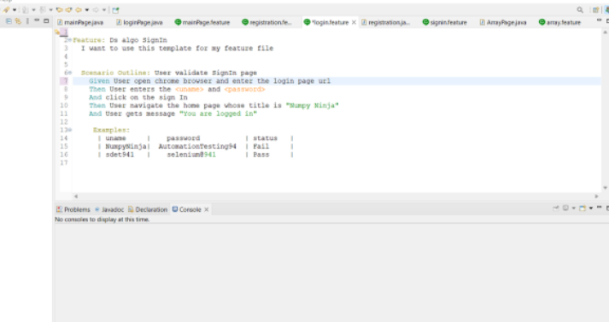
Cucumber Data-Driven Testing Using Example and Scenario Outline
Scenario Outline - An outline of a scenario can be used to replicate an experiment with many data variations. E.g. It is possible to data-drive our scenario twice, allowing for simultaneous user logins.
Examples - All case study descriptions must be followed by a detailed set of examples. Information that must be conveyed to the scenario is stored here.

Slide 27
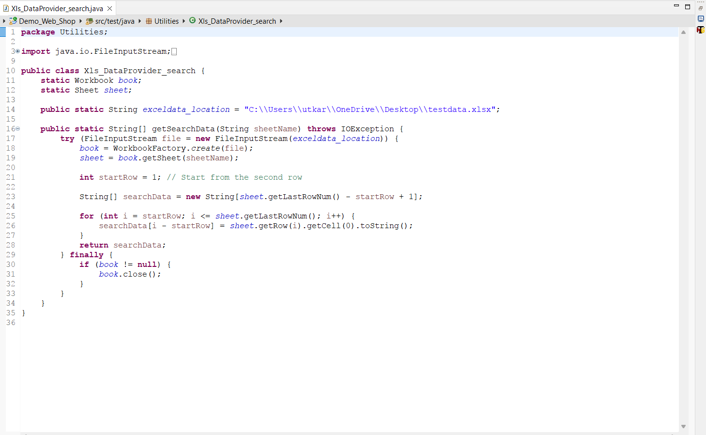
Functions used while implementing with Excel Sheet
FindBy()
FileOutputStream()
fos.flush()

Slide 28
Advantages of Data Driven Testing:
Multiple sets of data can be tested with ease during regression testing
Confidential data need not be hard coded
Can be reused in different tests
Maintenance and management of test scripts is easy
Time saving, efficient and reduce costs

Slide 29
TestNG Listeners and IRetry Analyzer
TestNG listeners allows you to customize and control the behavior of your tests.
It is an interface that modifies the TestNG behavior.
listeners are the piece of code that listens to the every events that occurs in a different stages of the test execution lifecycle in the TestNG.
It is activated either before the test or after the test case.
ITestListener:
ITestListener is the most used listener in TestNG.

Slide 30
ITestListener is an interface implemented in the class, and that class overrides the ITestListener-defined methods.➢
ITestListener listens to specific events and executes the code written inside the method and also we can log the events onto the reports.
The ITestListener contains the following methods:
onTestStart(): An onTestStart() is invoked only when any test method gets started.
onTestSuccess(): An onTestSuccess() method is executed on the success of a test method.
onTestFailure(): An onTestFailure() method is invoked when test method fails.
onTestSkipped(): An onTestSkipped() run only when any test method has been skipped.
onTestFailedButWithinSuccessPercentage(): This method is invoked each time when the test method fails but within success percentage.
onStart(): An onStart() method is executed on the start of any test method.
onFinish(): An onFinish() is invoked when any test case finishes its execution.
Listeners can be implemented in two ways in TestNG:
At the class level: Annotating listeners on each class in the test code.
At the suite level: Define the class names to implement listeners in the TestNG XML file.

Slide 31
IRetryAnalyzer
IRetryAnalyzer is an interface that allows you to implement a custom logic for test case retry mechanisms.
When a test method fails, TestNG can re-run the failed test method based on the implementation provided by a class that implements.
IRetryAnalyzers retry() method returns true if we need to retry and re-execute our tests otherwise, it returns false.
There are two ways to retry tests using TestNG:
Using the retryAnalyzer attribute in the @Test annotation
Using Retry class with IAnnotationTransformer interface

Slide 32
Extent Reports and Log4j
Extent Reports is a Java-based reporting library that facilitates the creation of comprehensive and interactive HTML reports for test automation.
It is commonly used in conjunction with testing frameworks like Selenium and Cucumber to enhance the presentation and analysis of test results.
Benefits of using extent report
Extent Reports generate visually appealing HTML reports that include charts, graphs, and interactive dashboards.
The reports provide a detailed summary of test executions, including the number of passed, failed, and skipped tests.

Slide 33
Extent Reports allow the inclusion of screenshots for failed test steps, providing visual evidence of the issues.
Extent Reports can be easily integrated with popular test automation frameworks like TestNG, JUnit, Selenium, and Cucumber.
Users can customize the appearance and structure of Extent Reports to meet project-specific requirements.
Extent Reports contain two major, frequently used classes:
ExtentReports class
ExtentTest class
Both classes can be used with the following built-in methods:
startTest: Executes preconditions of a test case
endTest: Executes postconditions of a test case
Log: Logs the status of each test step onto the HTML report being generated
Flush: Erases any previous data on a relevant report and creates a whole new report
A Test Status can be indicated by the following values:
PASS
FAIL
SKIP
INFO

Slide 34
SCREENSHOT FOR TEST FAILURE:
Create a class. Implement TestNG ITestListener.
Call the method onTestFailure.
In the extent test on fail call screenshot class and use them in: Test level (OR) Log level
Get Failed test a message and status and take a screenshot.
What is Log4j?
Log4j is a robust and versatile logging framework for Java applications.
It facilitates the generation of log messages from various parts of your code.
Key Features:
Configurability: Log4j allows configuration through XML, JSON, or properties files, providing flexibility in adjusting logging behaviour without code modifications.
Logging Levels: Supports different logging levels (TRACE, DEBUG, INFO, WARN, ERROR, FATAL) to help categorize and filter log messages based on severity.
Appender System: Utilizes an appender system to define output destinations (console, file, database, etc.) for log messages. Multiple appenders can be used simultaneously.

Slide 35
Asynchronous Logging: Supports asynchronous logging, improving performance by minimizing the impact of logging on the application's execution time.
Logger Hierarchy: Implements a logger hierarchy, enabling fine-grained control over logging at different levels of the application's package structure
Development and Debugging: Log4j is invaluable during development and debugging, helping developers trace the flow of their code and identify issues.
Layouts: Offers customizable layouts for log messages, allowing developers to control the format in which log entries are displayed.

Slide 36

JIRA
JIRA is a project management software developed by the Australian company Atlassian.
Many businesses also use JIRA software in non-standard ways as warehouse automation tool, document flow, expenses optimization, and others.
The JIRA dashboard contains several useful functions and features which enable easy handling of issues.
One of the most sought after agile project management solutions, JIRA has recently tweaked some of its products for all kinds of teams and organizations including IT, marketing, operations, finance, HR, legal and other departments.

Slide 37
Key JIRA concepts
Projects
They are used to organize and manage work within Jira. Each project contains a set of issues and can have its own custom fields, workflows, and permission schemes.
Issues
They represent tasks, bugs, and other work items that need tracking and managing.
Workflows
Boards
They are used to visualize and manage the progress of issues in a project. Jira has three types of boards: Scrum boards, Kanban boards, and Agile boards.
Sprints
Sprints are time-boxed periods of work in Scrum methodology. Sprints help teams to focus on a specific set of tasks and deliverables within a fixed timeframe.
Epics
They provide a high-level view of the work that needs to be done and help teams to prioritize their work.

Slide 38
Dashboards
Dashboards provide a customizable view of project information, such as status, progress, and key metrics.
Advantages of JIRA
JIRA is a bug tracking tool that allows software developers to plan, track and work faster.
JIRA is the main source of information for future software release.
Developers can plan new features to be added and bugs to be fixed in the next release.
Organize Documentation Tasks
Track Documentation Progress
Helps Meet Deadlines
Provides Faster Feedback
Integration Available with third-party software

Slide 39
SCREENSHOTS

Slide 40
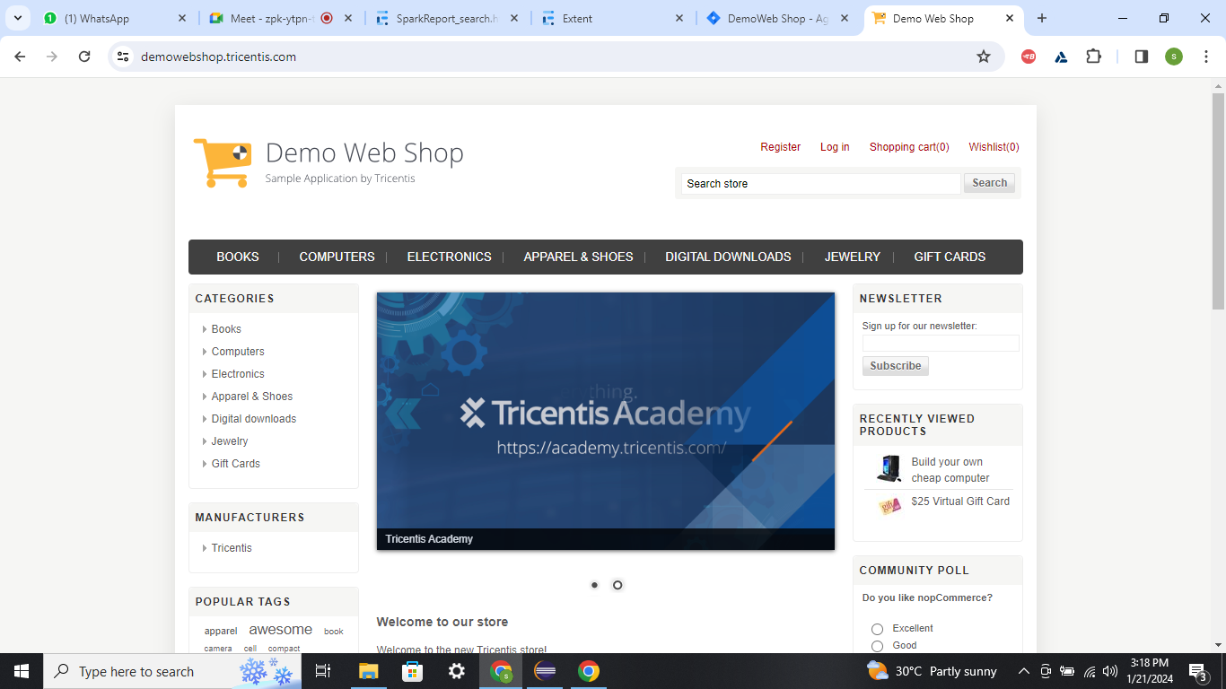

Slide 41
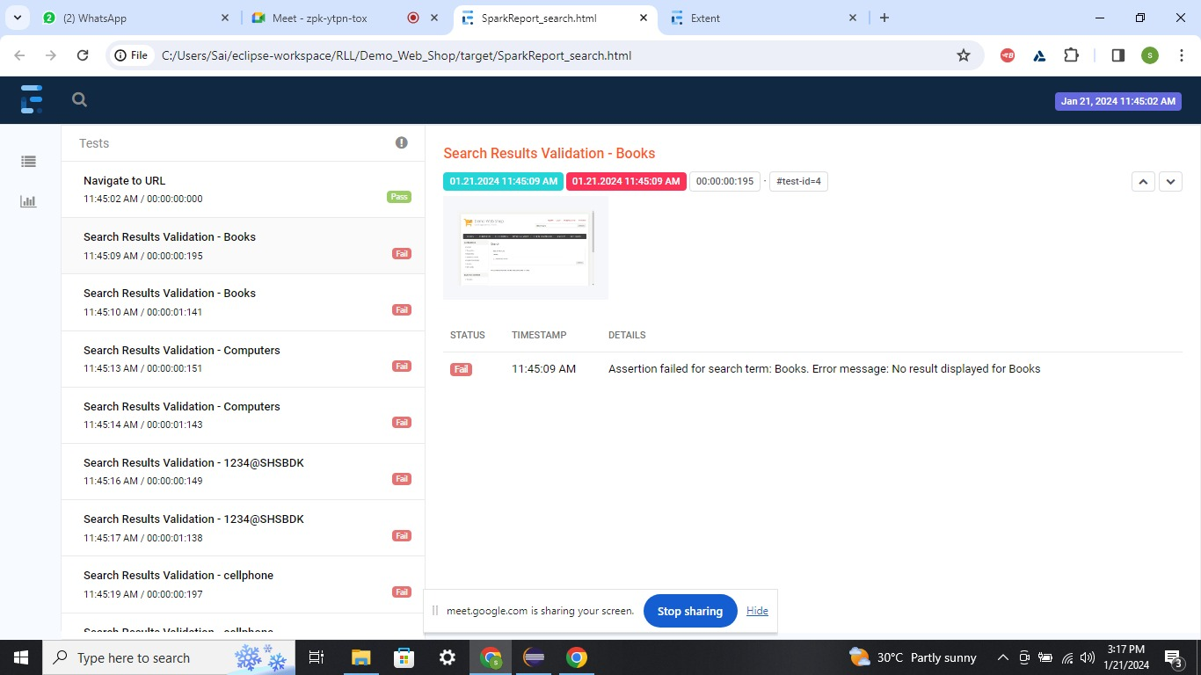
Customized_report

Slide 42
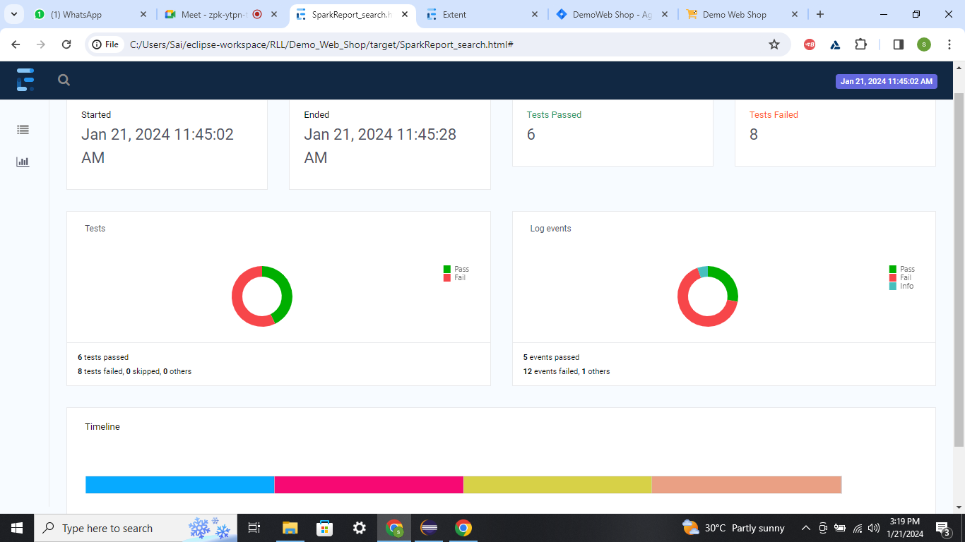

Slide 43
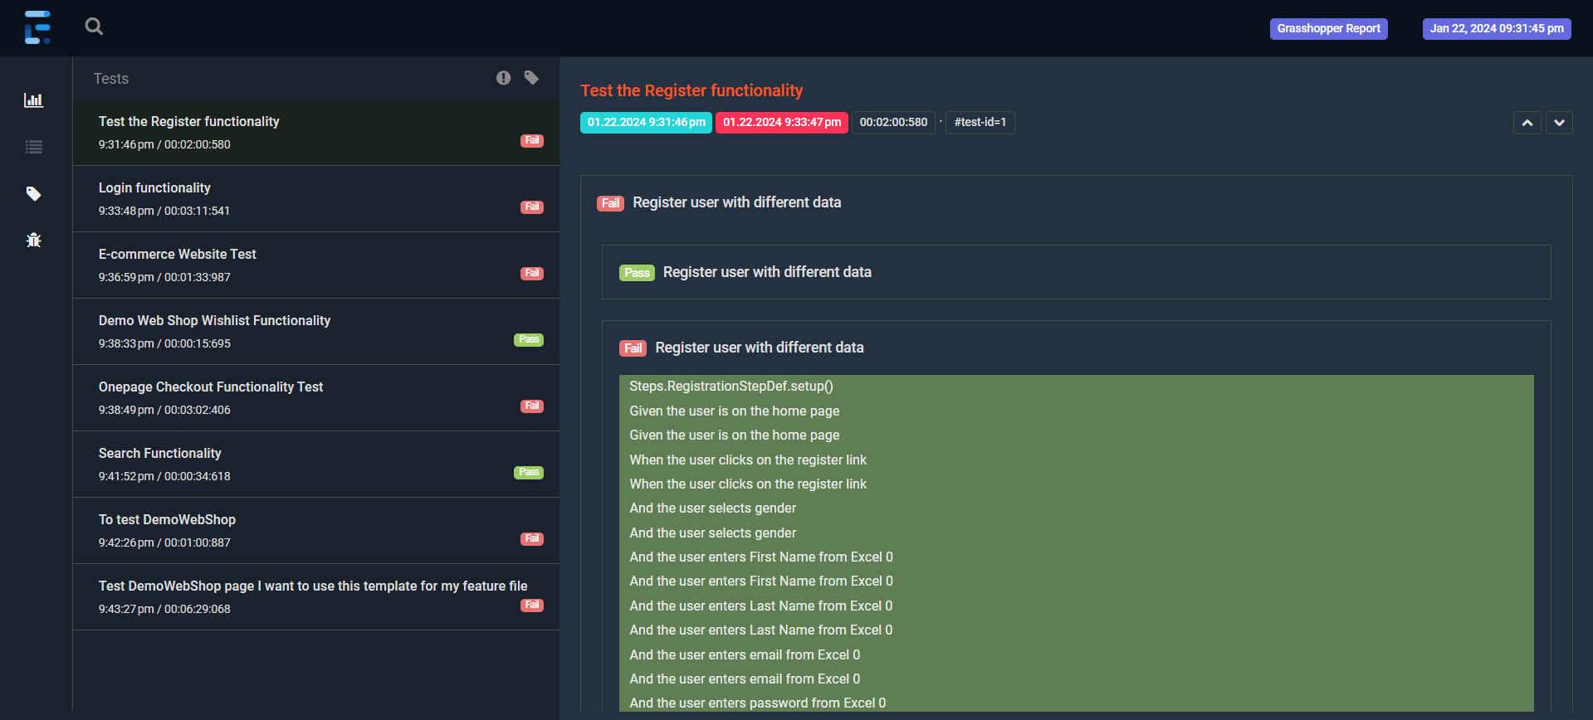
Report using properties file

Slide 44
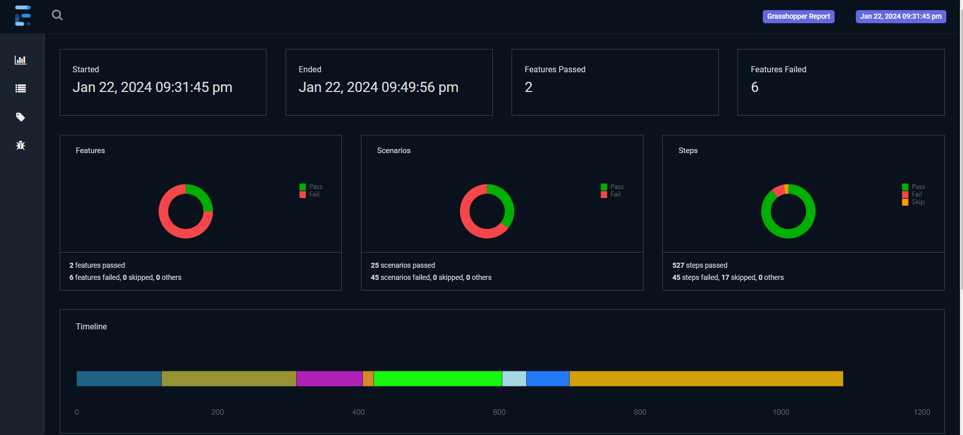

Slide 45
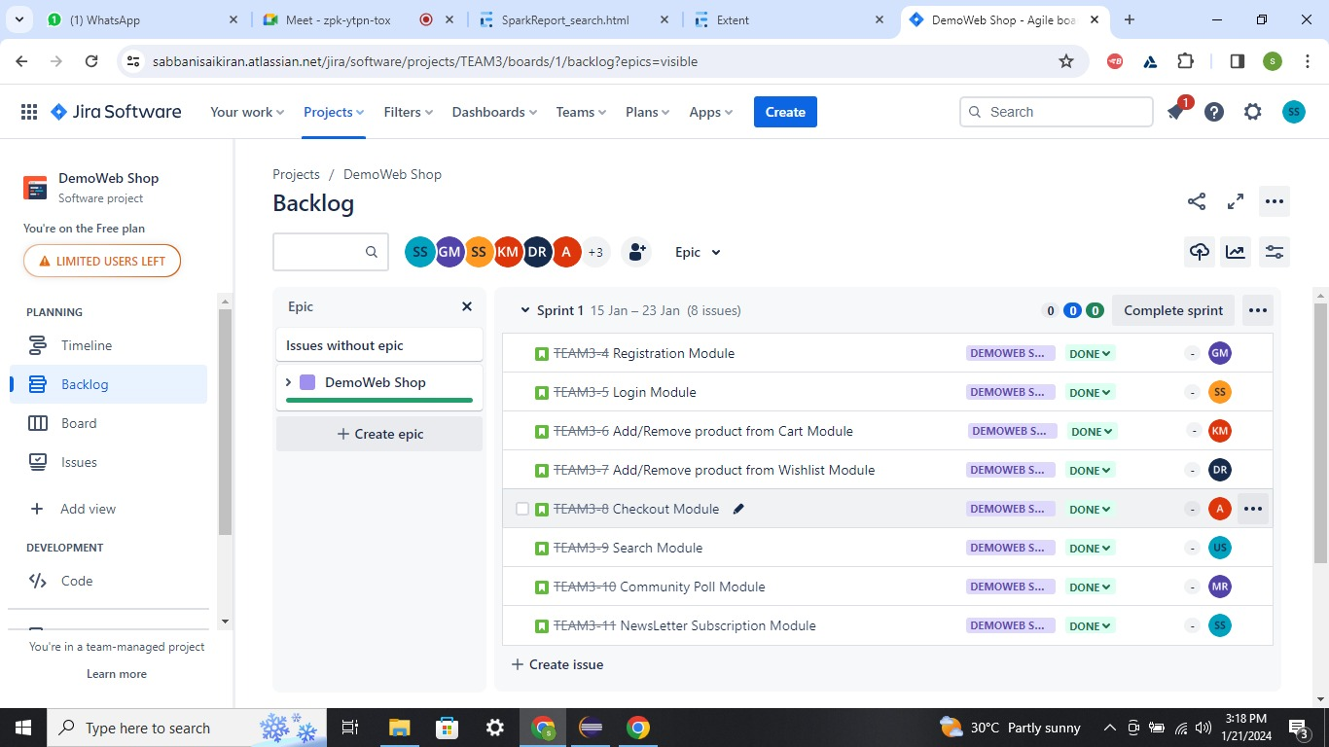

Slide 46
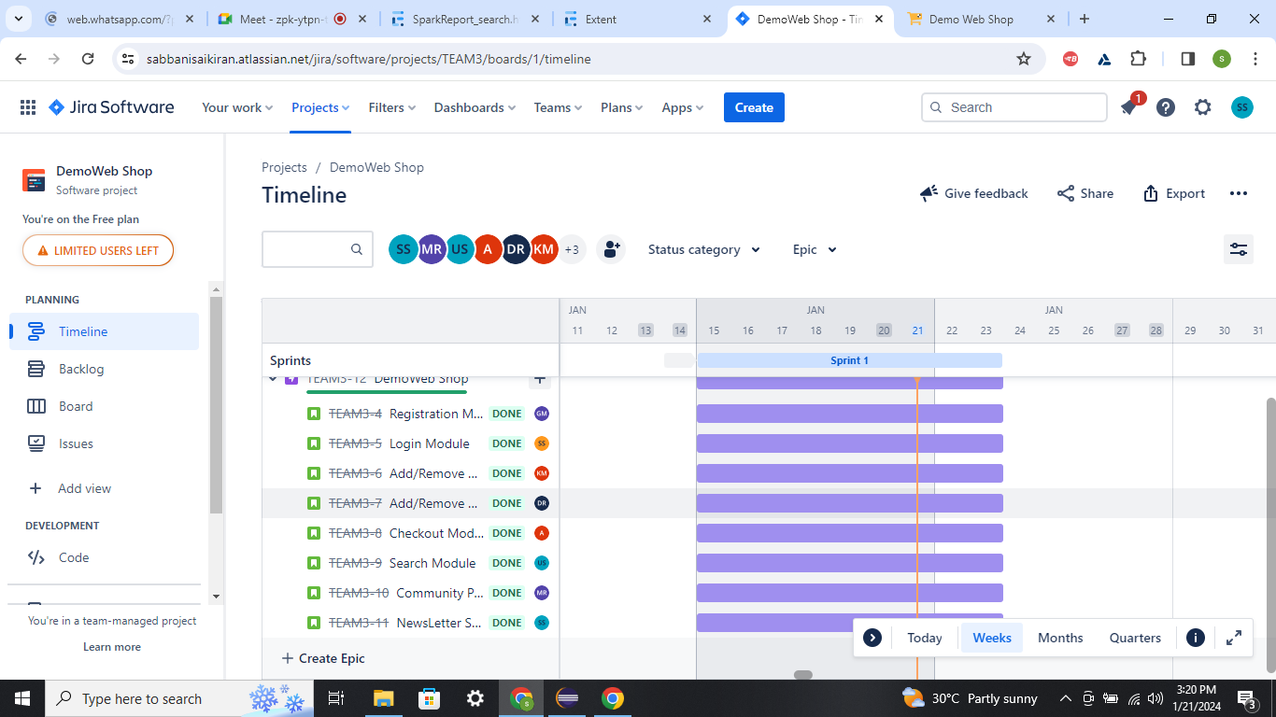

Slide 47
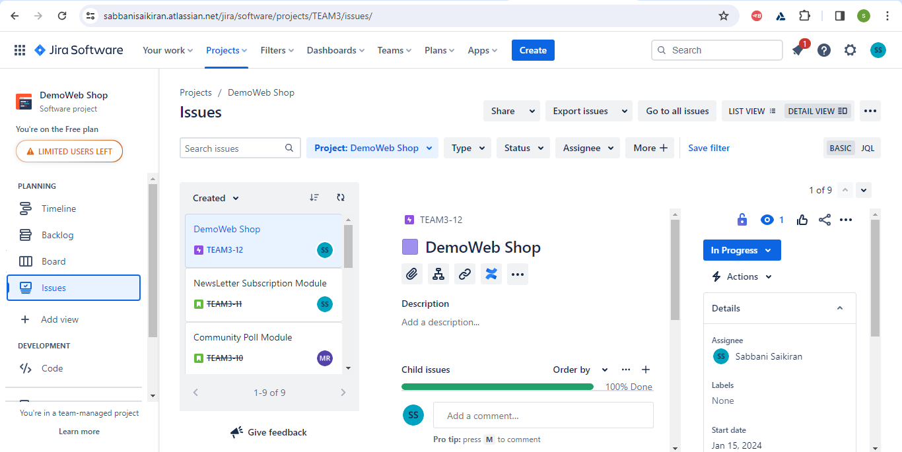

Slide 48
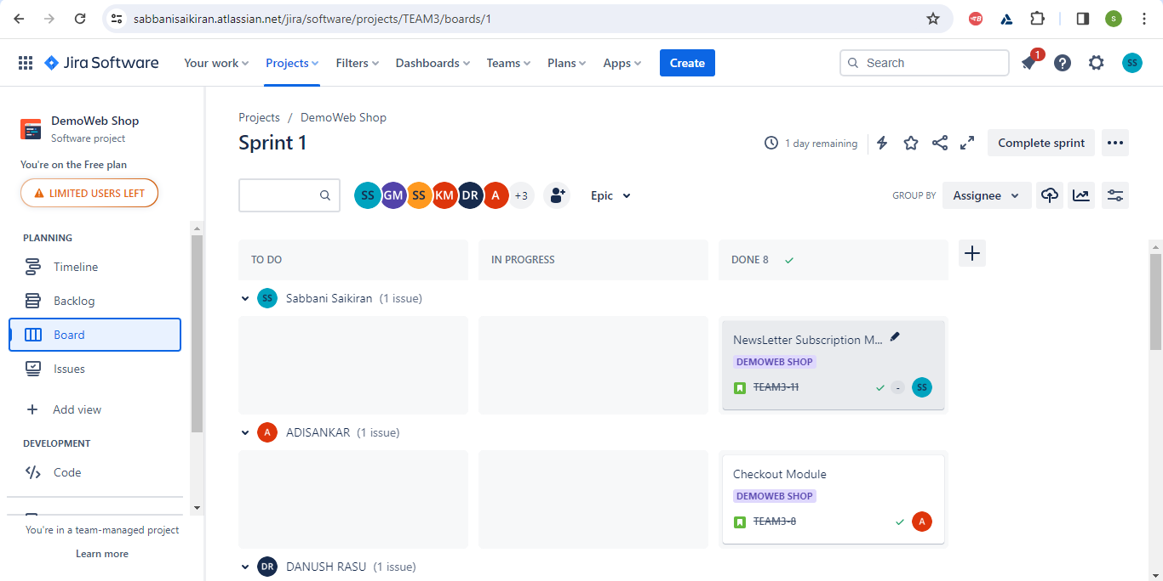

Slide 49
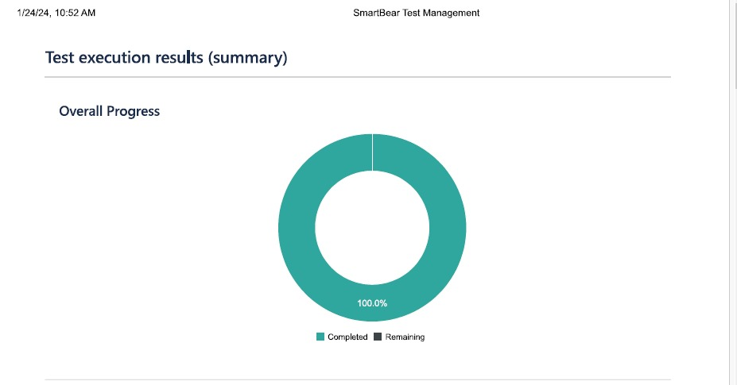

Slide 50
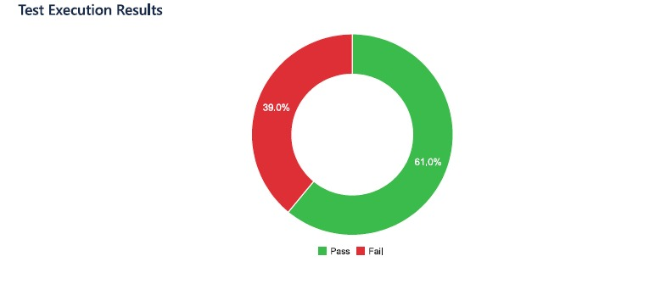

Slide 51
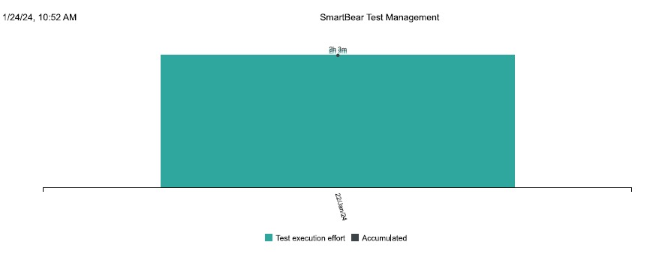

Slide 52
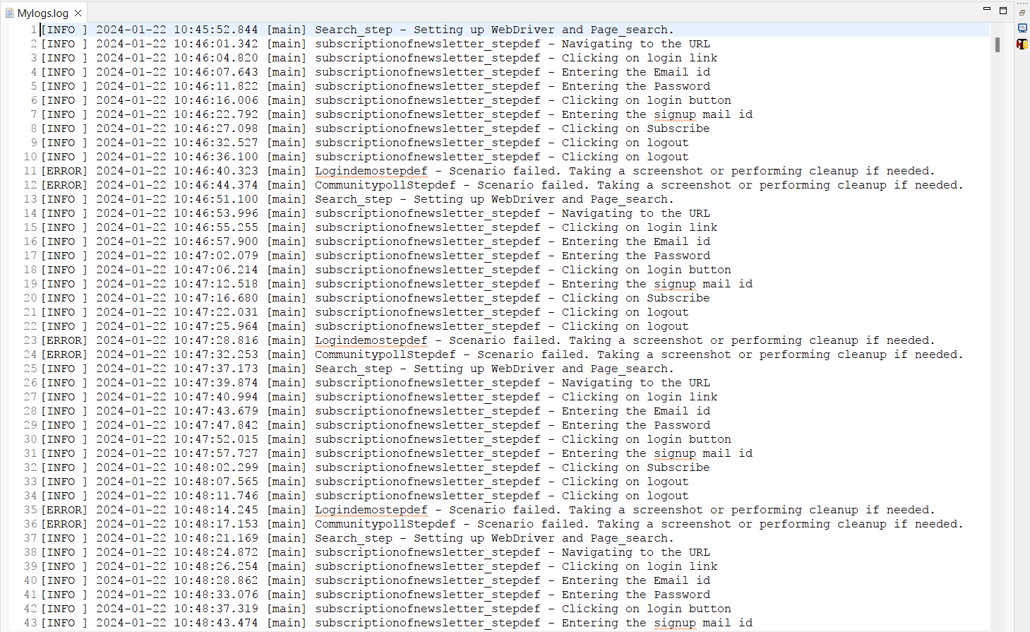

Slide 53
Conclusion
Quick summary of the key requirements
Hybrid Automation Framework, Five Utilities, POM Framework, Best Practices Implementation, TestNG Features (Retry, Custom Reporting), Jenkins Integration and JIRA for Test Management Lifecycle

Slide 54
Thank You

